Slide 1
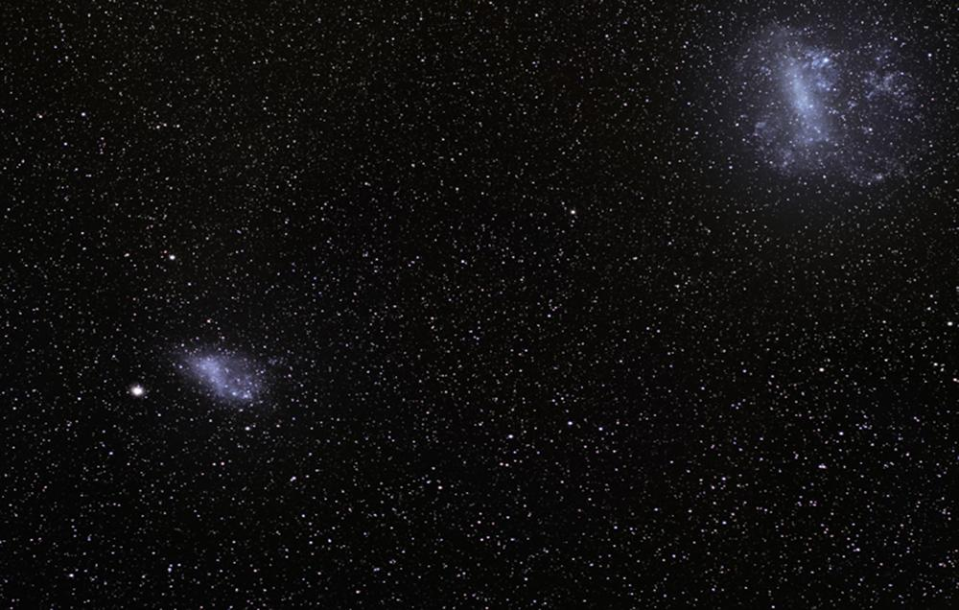

NASA Path: Final Presentation
Software Engineering Project SWEN 670 2178
André Akinyele, Jeffery Dovan, Erika Guthrie, Tracy Hill, Pyae Kyaw, & Derek Stine
Sponsor: Extra-Vehicular Activity (EVA), Johnson Space Center, NASA
Liaison: Daren Welsh, EVA Instructor & Flight Controller | darenwelsh@gmail.com
Notes:
Project: NASA Path.
Group Members: André Akinyele; Jeffery Dovan; Erika Guthrie; Tracy Hill; Pyae Kyaw; and Derek Stine (SWEN 670 2178, Fall 2017).
Sponsor: Extra-Vehicular Activity (EVA), Johnson Space Center, NASA
Liaison: Daren Welsh, EVA Instructor & Flight Controller | darenwelsh@gmail.com

Slide 2
Project Overview
Client wanted the team to create an algorithm that found the shortest exterior paths of the International Space Station (ISS) using a 3D model. The client also wanted to know when a crew member was at a particular location and needed to get to another place on the other end of ISS. Using a modified Dijkstra’s Algorithm, the team created maps and navigation for the exterior of the ISS, using handrails and structural beams that told which path were the shortest distance, path encountered the least hazards, and path required longer arm reach. The Dijkstra’s Algorithm found the shortest path between two points modified for 3D. The design is similar to Google Maps with navigation. The client had a 3D model of the exterior of the Space Station, complete with handrails and other interfaces useful to a spacewalker. Therefore, the team created an algorithm using the Dijkstra’s Algorithm, modified for 3D, that found the shortest paths for the exterior of the ISS using a 3D model with the new EVA Navigator application.

Slide 3
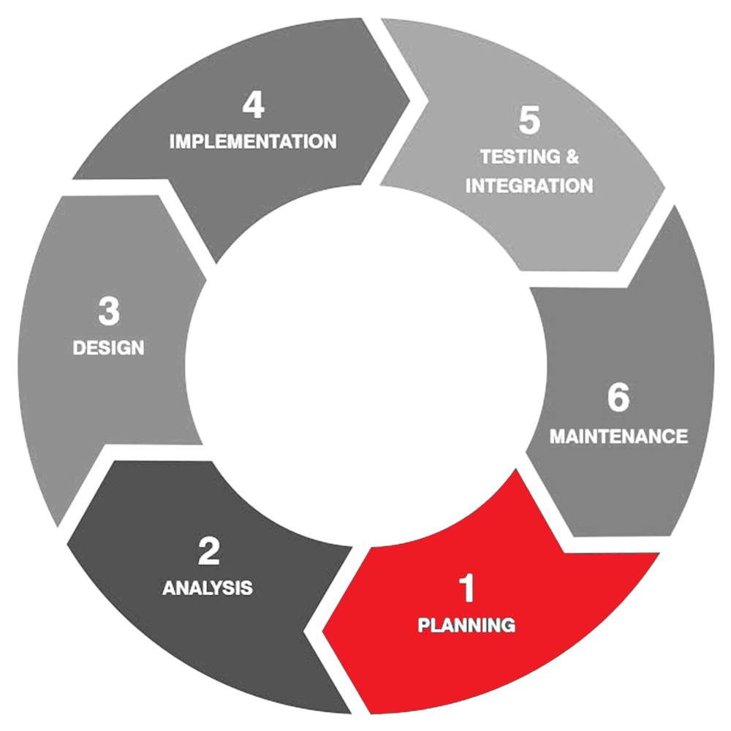
PLANNING NASA PATH
Notes:
Planning, executed by the Project Manager, includes the project objectives, statement of work (SOW), assumptions and constraints, work breakdown structure (WBS), project description, and utilized methodologies.

Slide 4
Software Development Plan Planning Purpose
To design a comprehensive strategy required in developing, modifying, or upgrading the NASA Path software program, which provided the following:
Aspects of each step and its required deliverables.
Aspects from the project’s process of software development implementation, documentation, through the software testing lifecycle and deployment.

Slide 5
Software Development Plan Planning Scope
To develop an algorithm that found the shortest exterior paths of the International Space Station (ISS) using a 3D model, similar to Google Maps with navigation, that included:
Navigation mapping for the exterior of the ISS using handrails and structural beams that stated which…
Path was the shortest distance
Path encountered the least hazards, and
Path required longer arm reach

Slide 6
Software Development Plan Planning Objectives
Analyze the software requirements and interface software architecture.
Decompose the software requirements and interface software architecture.
Determine requirements and deliverables.
Form development teams based on skill set and resource availability.
Employ communications management via weekly meetings.

Slide 7
Software Development Plan Measured Accomplishments
Milestone 1: Delivered – October 1, 2017
Project Plan
PowerPoint Presentation
Milestone 2: Delivered – October 22, 2017
Software Requirements Specification
Test Plan
Pseudocode
Milestone 3: Delivered – November 12, 2017
Prototype (Demo)
Testing
Milestone 4: Delivered – December 3, 2017
Regression
Quality Assurance
Signoff
PowerPoint Presentation
Final Application Delivery

Slide 8
Software Development Plan Statement of Work (SOW)
The final program was to:
Inform the client as to which path was the shortest distance, path encountered the least hazards, and path required longer arm reach when a crewmember was at a particular location and needed to get to another place on the other end of ISS.
The program was to consist of:
Creating an algorithm that found shortest paths for the exterior of the ISS using a 3D model with the Dijkstra Algorithm, as it finds the shortest path between two points in a graph and is modifiable for 3D.
Creating maps and navigation for the exterior of the ISS (using handrails and structural beams).
Designing something like Google Maps with navigation.

Slide 9
Software Development Plan Principal Needs
Users of the software are:
Astronauts
Astronaut Trainers
Space Walk Procedure Writers
The software will be used to:
Train astronauts on how to perform space walks
Plan astronaut’s spacewalks
Write astronauts procedures
Map out translation paths
Choreograph maneuvers involving robotic arm (SSRMS)
Avoid hazards (radiating antennas and sharp edges)
Deviate in real-time
Take input data for the user to establish the ideal path(s)
Display output data of the determined ideal path(s)

Slide 10
Software Development Plan
Assumptions:
Development can be web-based
No software language or technology preferences
“DOUG” program provides client with a 3D model, which allows highlighting handrail paths and hardware and has a “ruler” feature to estimate distances between two points. Due to difficulties gaining access to the “DOUG” application early in the project, the team chose React JS and ThreeJS for a browser-based 3D interface.
Sample data is shared on GitHub repo at http://github.com/darenwelsh/EVANav
If team formats the data as shown, “DOUG” developers can import it into the program
Team can estimate any path that requires a “plane change” by providing more time (when the body rotates from one translation plane to another – going around a corner or edge)
Constraints:
Must be executable on user’s computer (PC, OS X, and Linux)
Chosen software language must foster long-term support from collaborative development
If web-based, software must support more than one browser - Chrome, Firefox, and Internet Explorer (IE)
No “black box” delivery
User input interface should include start and end points, allow optional waypoints in the middle of the route, and allow options for route determination, which includes:
Avoiding crew hazards (things that hurt the crew or suit
Hardware hazards (things that could be hurt by crew)
Minimize rotations and plane changes
Field to enter crewmember’s wingspan
The output interface should include a visual representation of the available paths
The format of the objects for path calculation should be represented using nodes on a graph (a scene-graph)
Design the software similar to Google Maps with Navigation using a 3D model
If any of the model names include the word “antenna”, include some volume around it designated as a “Keep Out Zone”

Slide 11
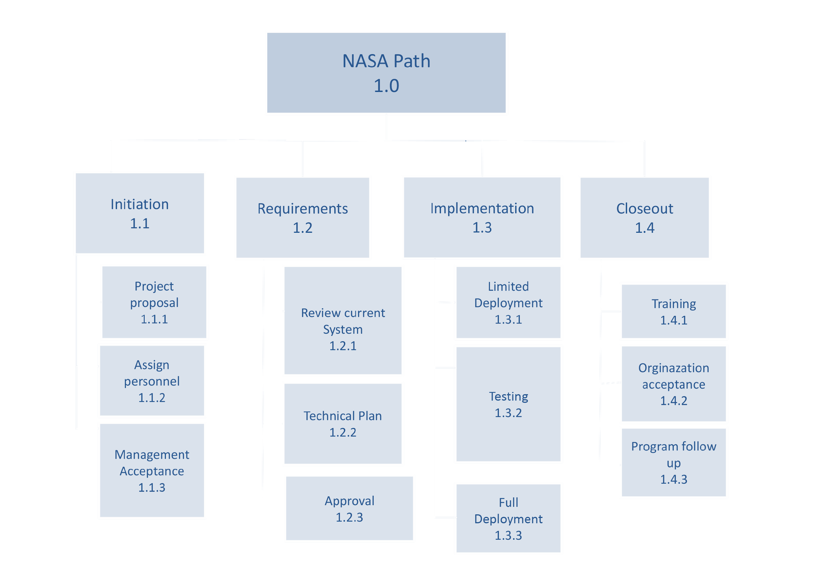
Software Development Plan Work Breakdown Structure (WBS)

Slide 12
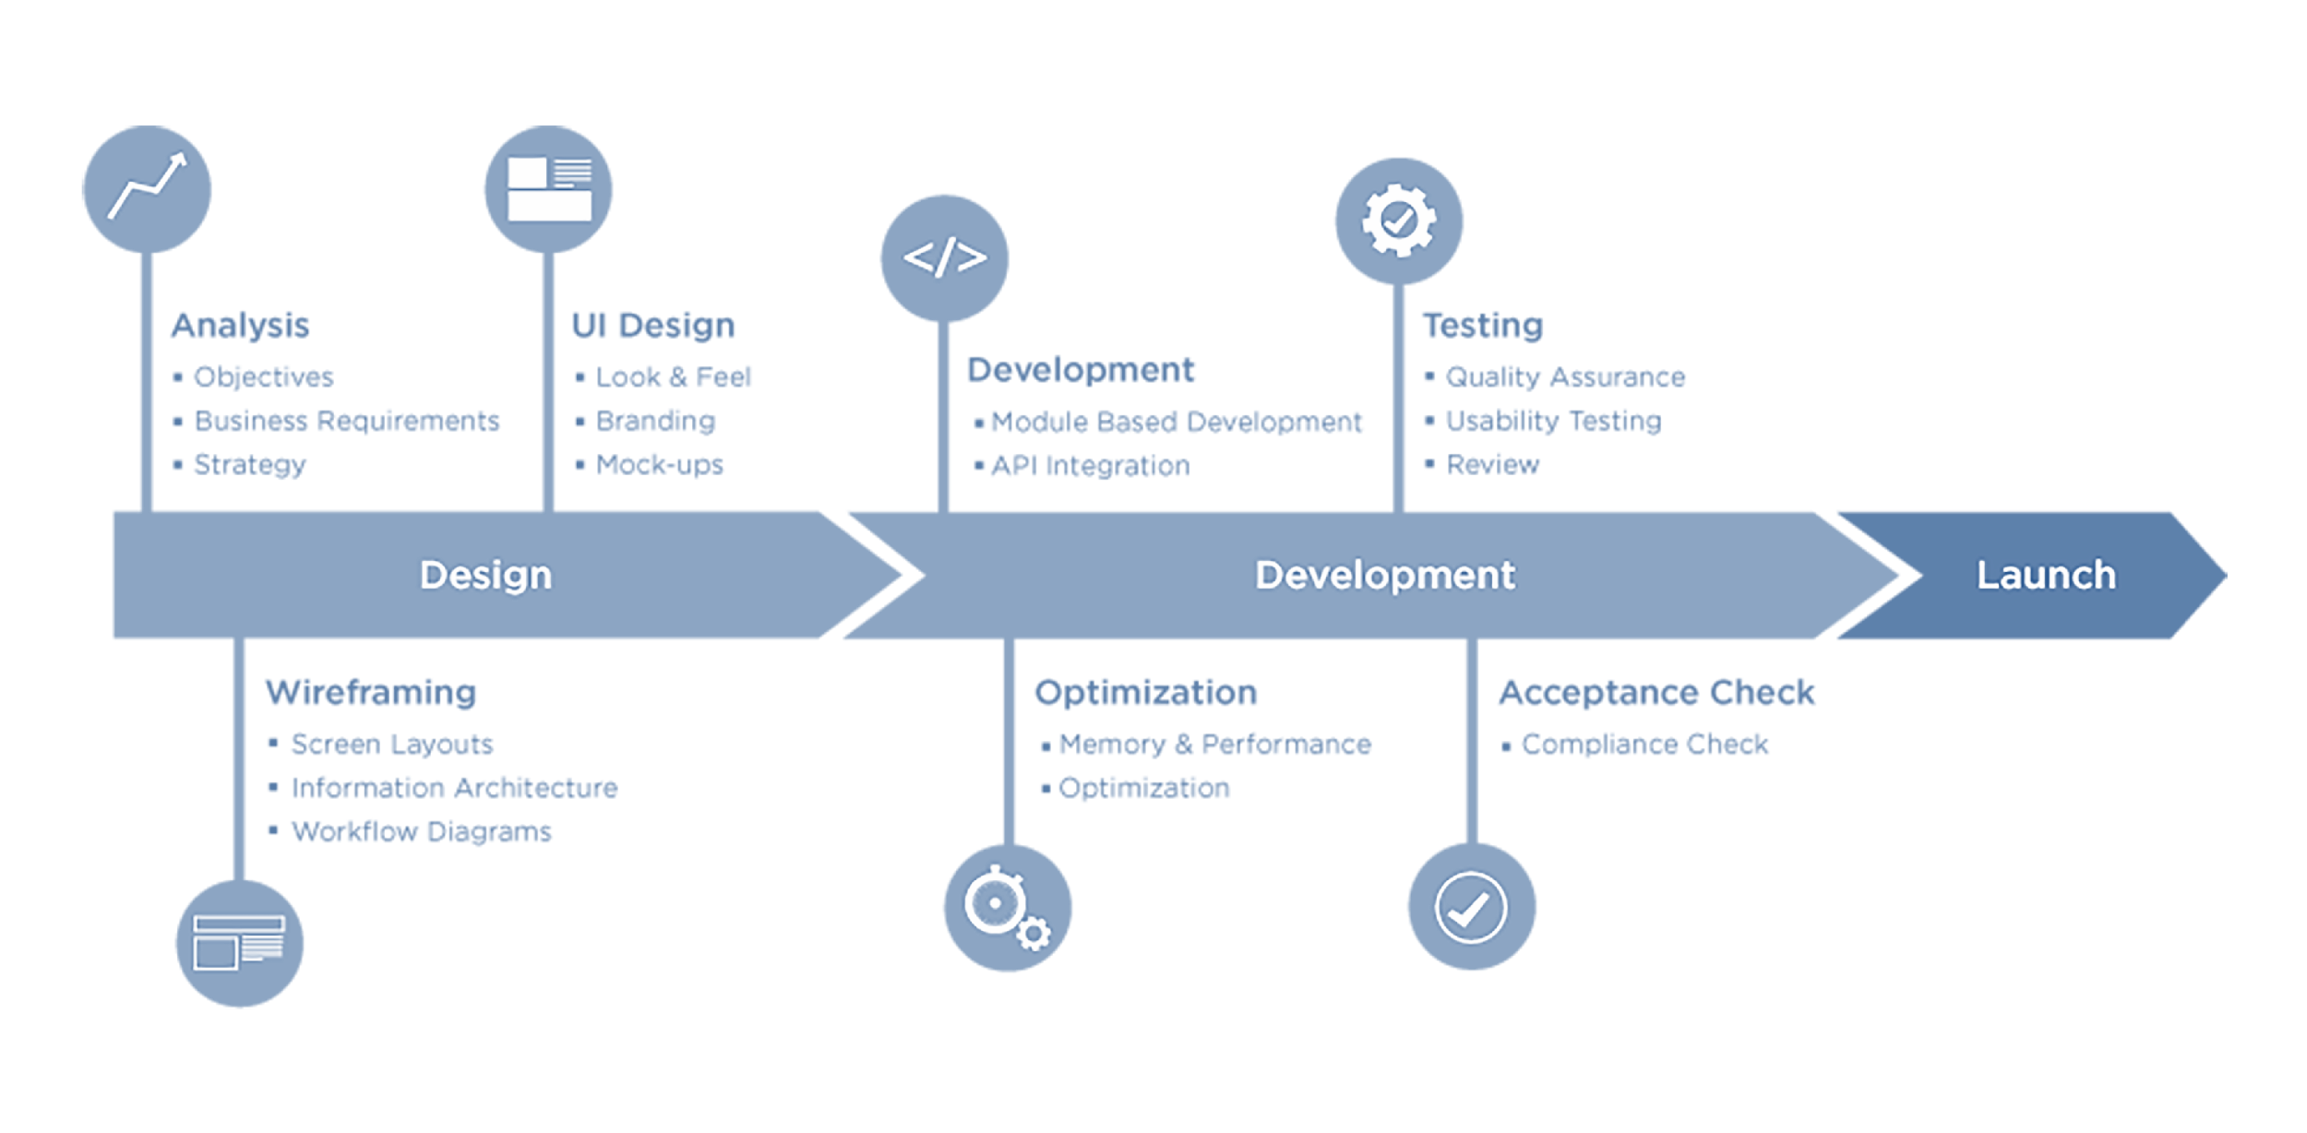
Software Development Plan Design Process

Slide 13
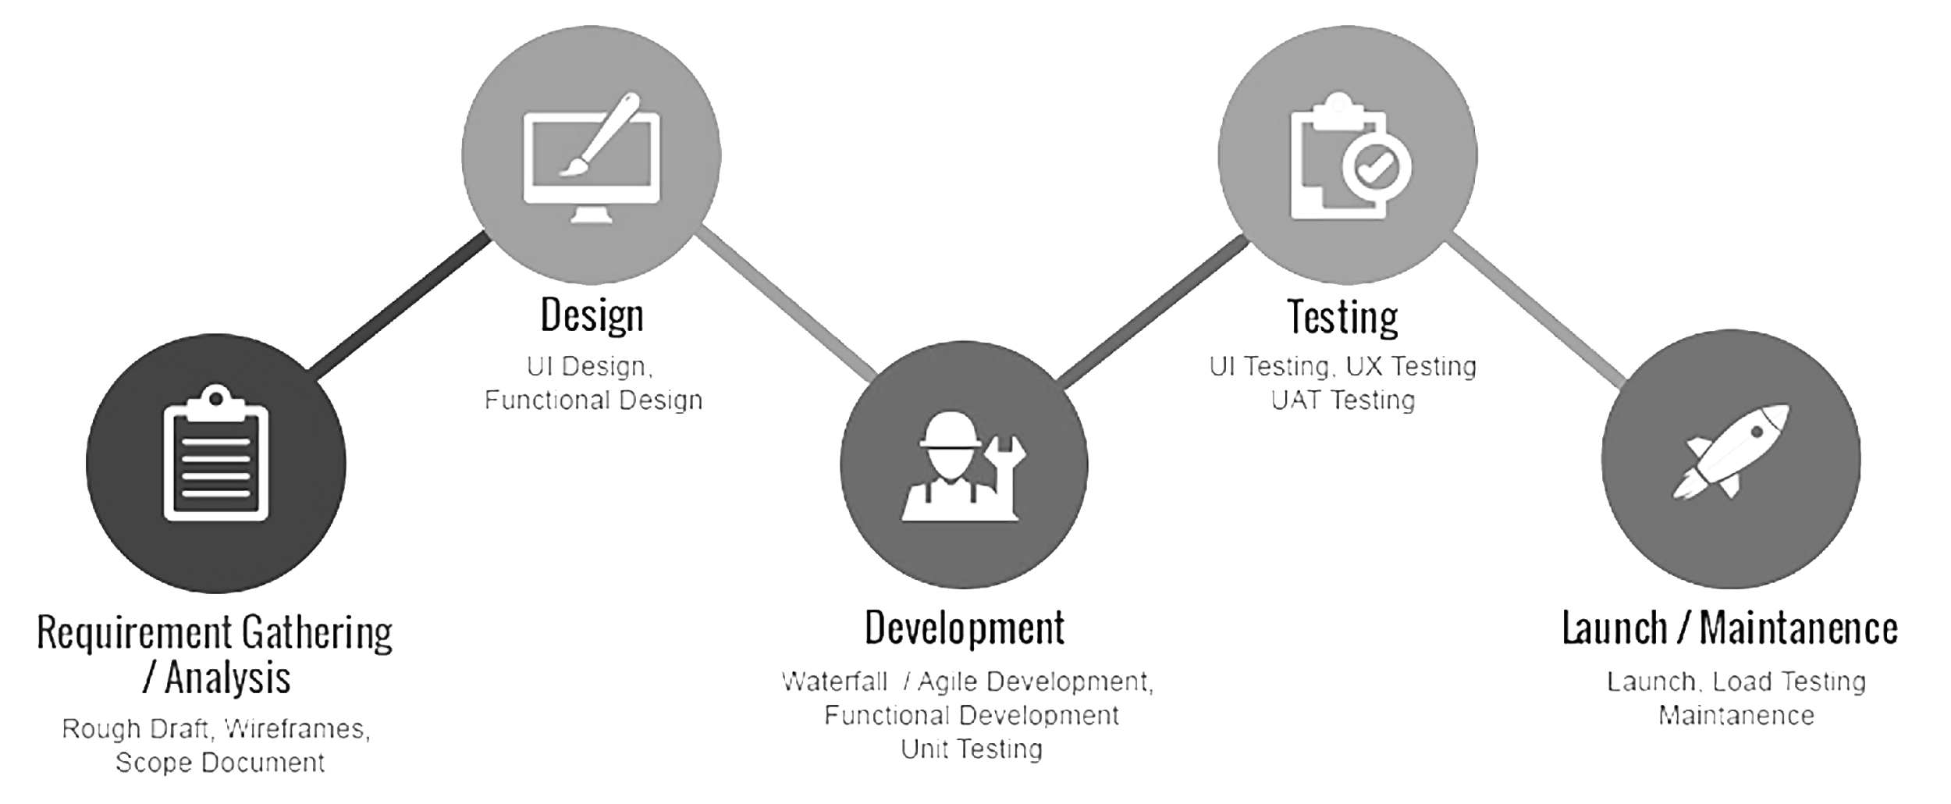
Software Development Plan Development Process

Slide 14
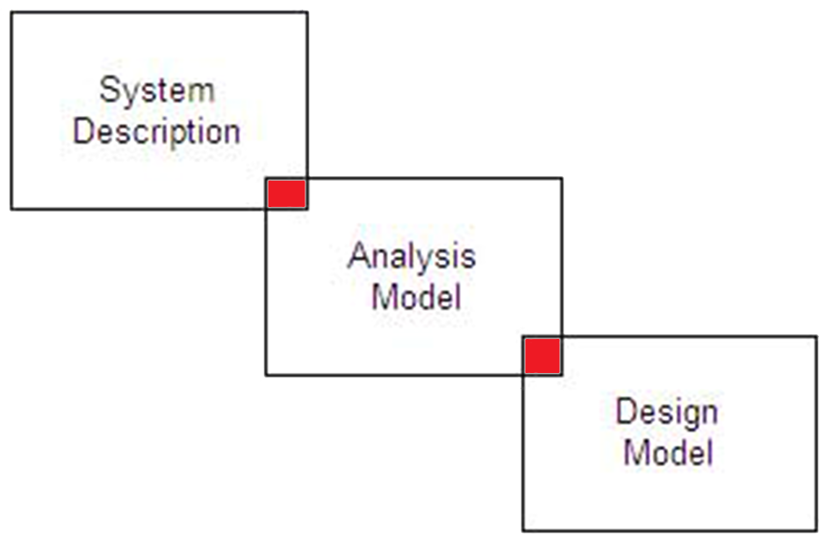
SOFTWARE REQUIREMENTS SPECIFICATION NASA PATH
Notes:
The software requirements specification provides the overall project description, system features, external and internal interface requirements and other nonfunctional requirements.

Slide 15
Software Requirements Specification SRS Purpose
Define the software functional and nonfunctional requirements.
Implement and verify the accurate functioning of the software.

Slide 16
Software Requirements Specification SRS Scope
Allow an algorithm to calculate valid paths around the exterior of the ISS using a 3D model:
Navigating crewmembers from their chosen start location to their chosen end location
Establishing a path’s shortest distance
Avoiding a path’s encounter with the least hazards, and
Determining a path’s validity taking into account entered arm reach
The software includes:
A 3D rendering for the exterior of the ISS and path using handrails and structural beams
Arm reach entered from ranges between 4ft. to 7ft.
A list of some objects protruding from the structural surface
Rendering paths in the software for users, where compatibility with “DOUG” application is of less concern

Slide 17
Software Requirements Specification SRS Software Perspective
An algorithm that calculates valid paths around the exterior of the ISS using a 3D model:
Determine crewmember’s particular location
Navigate crewmembers
Establish path(s) shortest distance
Encounter the least hazards
Determine path(s) requirement for within the specified arm reach
Maps and navigation for the exterior of the ISS using handrails and structural beams:
Arm reach (from a slider that ranges from 4ft. to 7ft.)
List of some objects protruding from structural surface
Render the paths in the software for user

Slide 18
Software Requirements Specification
Minimum Hardware Specification:
Monitor, Keyboard and Mouse
Internet Connection or Data Connection
To upload/download files
At least 3.4 GHz (CPU), 8GB (RAM), and 1GB (GPU)
For smooth operation of 3D software
10GB Free Disk Space
Minimum Software Specification:
Chrome/Firefox/IE 11 browser
Windows 7+/Mac OS X+/Ubuntu 14+

Slide 19
Software Requirements Specification SRS User Classes and Characteristics
Astronaut
A person who is trained to travel in a spacecraft
Several potential astronauts are expected to use the NASA Path software
Inputs data to establish ideal path(s)
Avoids hazards (radiating antennas and sharp edges)
Deviates in real-time due to contingencies or timeline constraints
Astronaut Trainer
Trains astronauts on how to perform spacewalks
Spacewalk Procedure Writer
Plans astronaut spacewalks
Writes astronaut procedures
Application
Imports NASA stl and str data
Displays data in a 3D model
Displays the ideal path(s) to the software

Slide 20
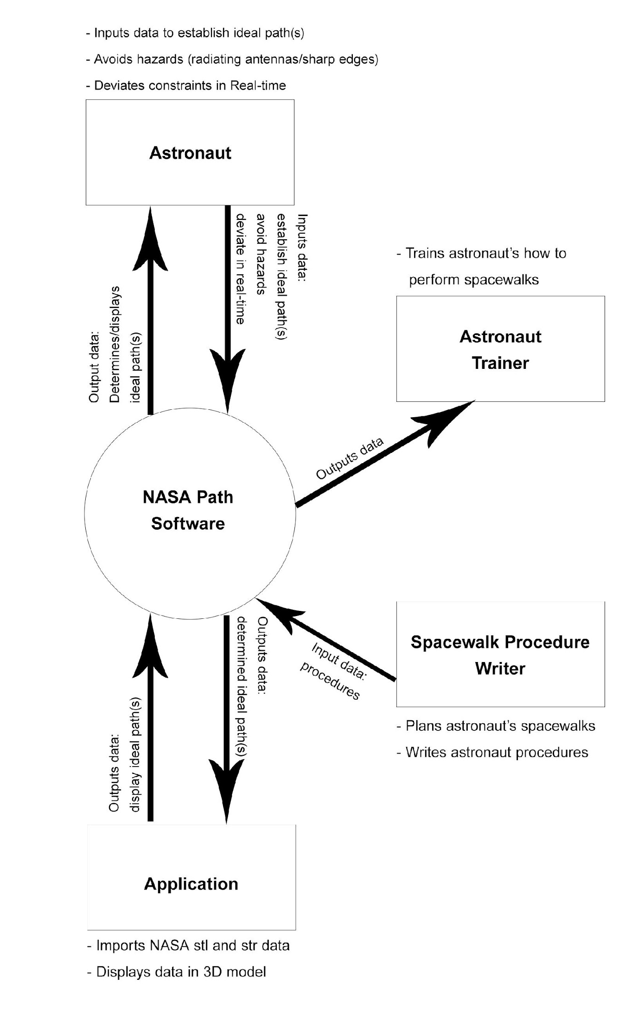
Software Requirements Specification Context Diagram

Slide 21
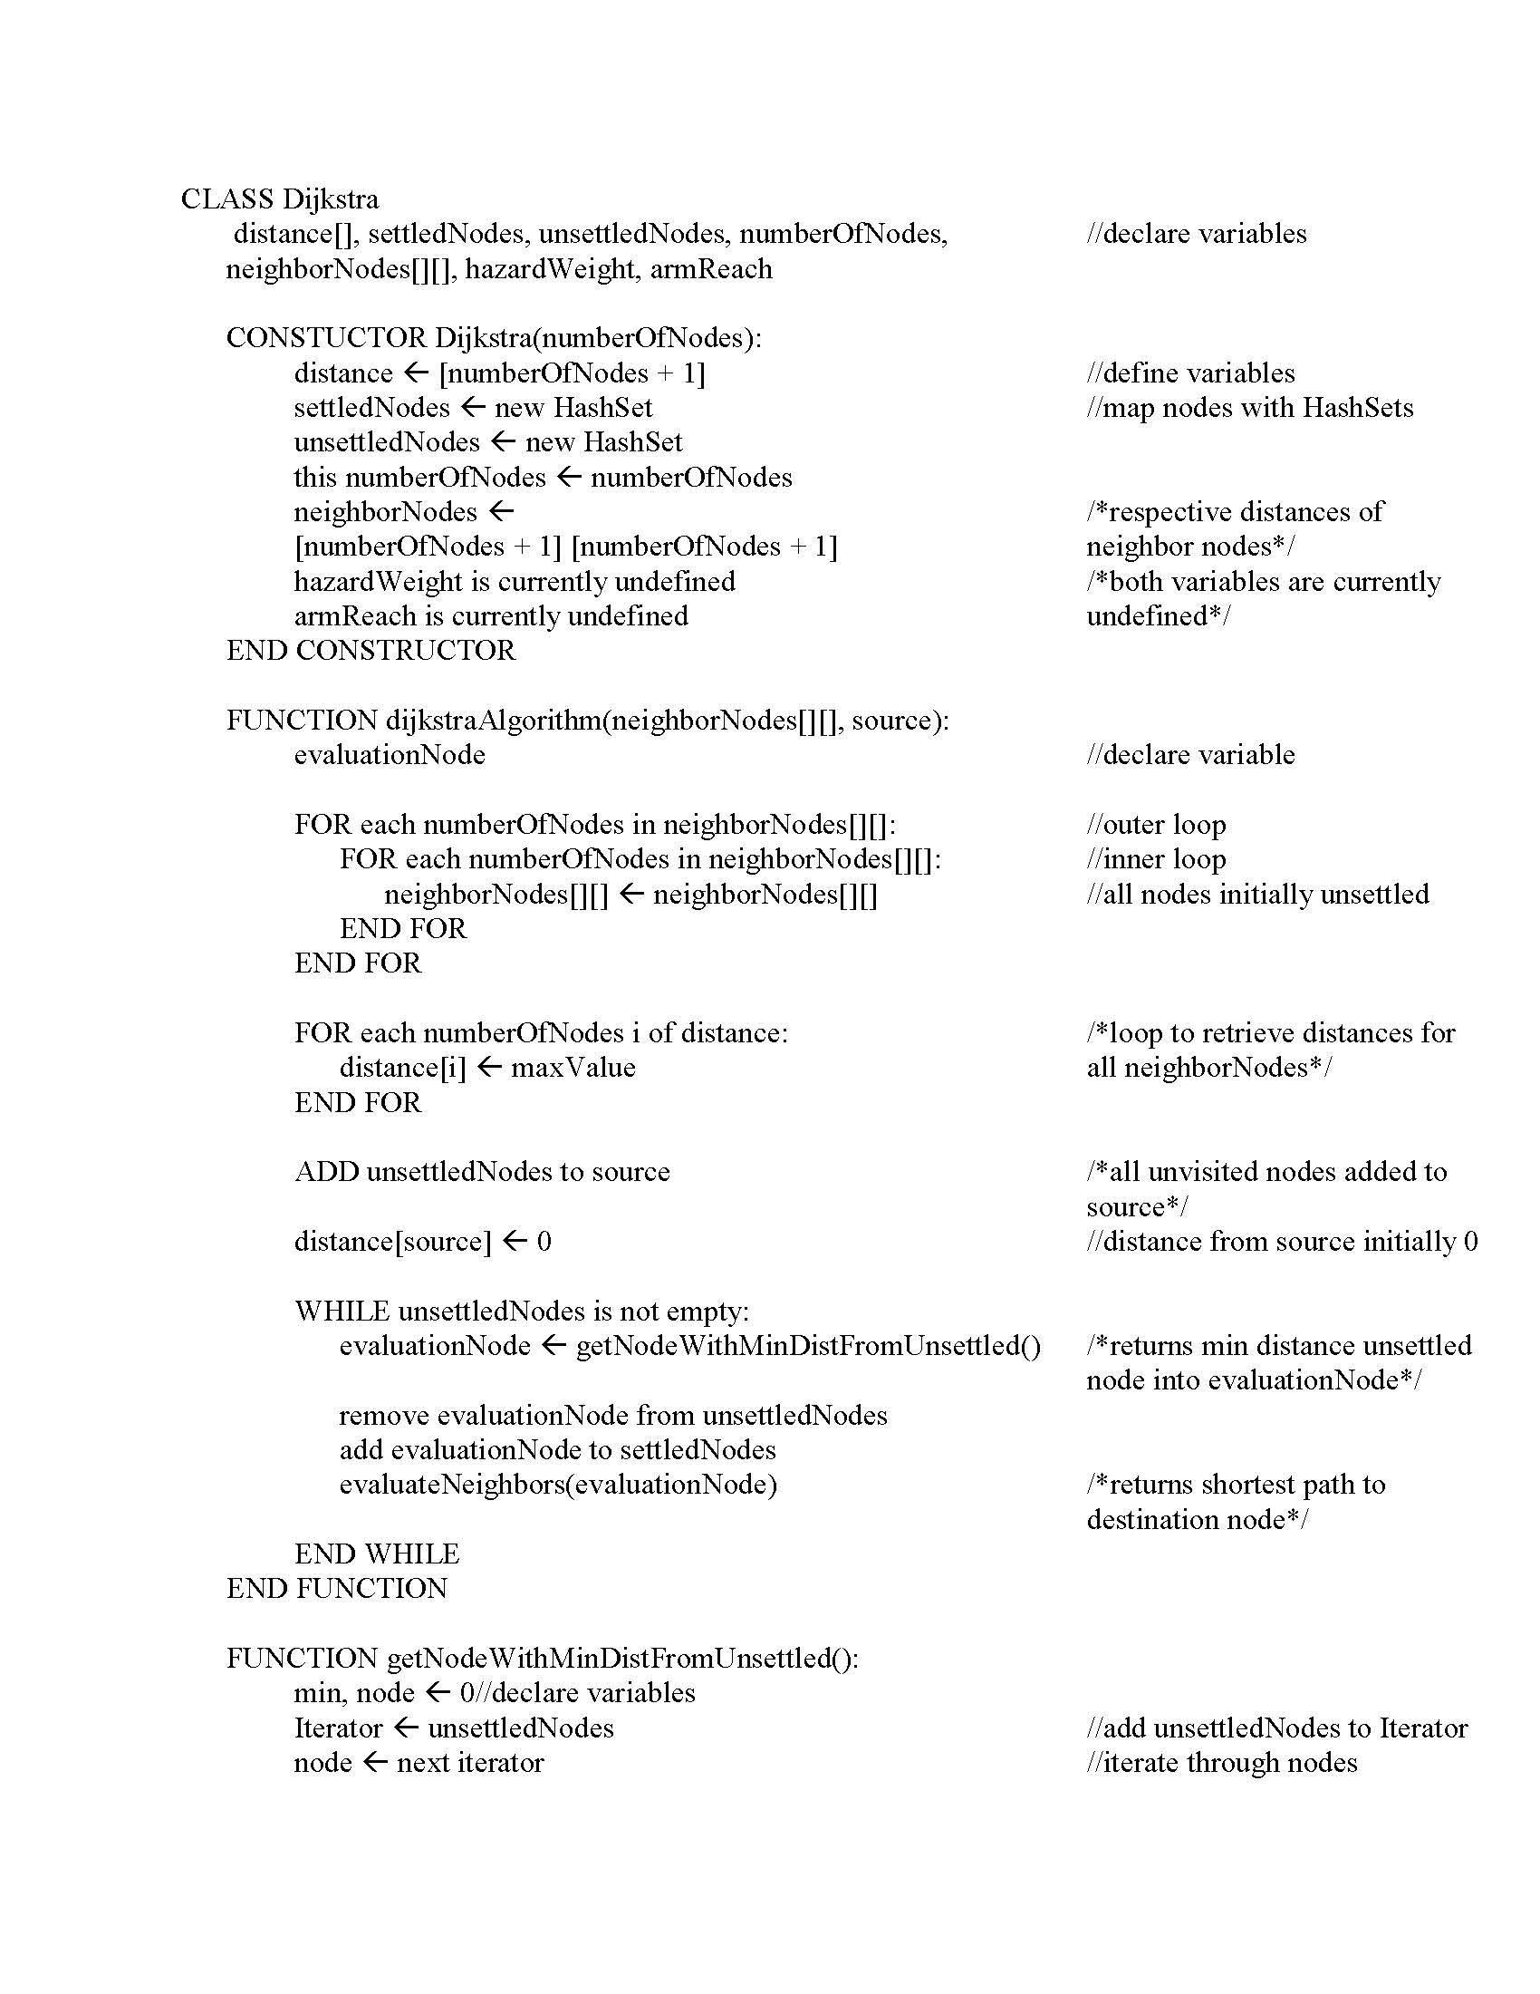
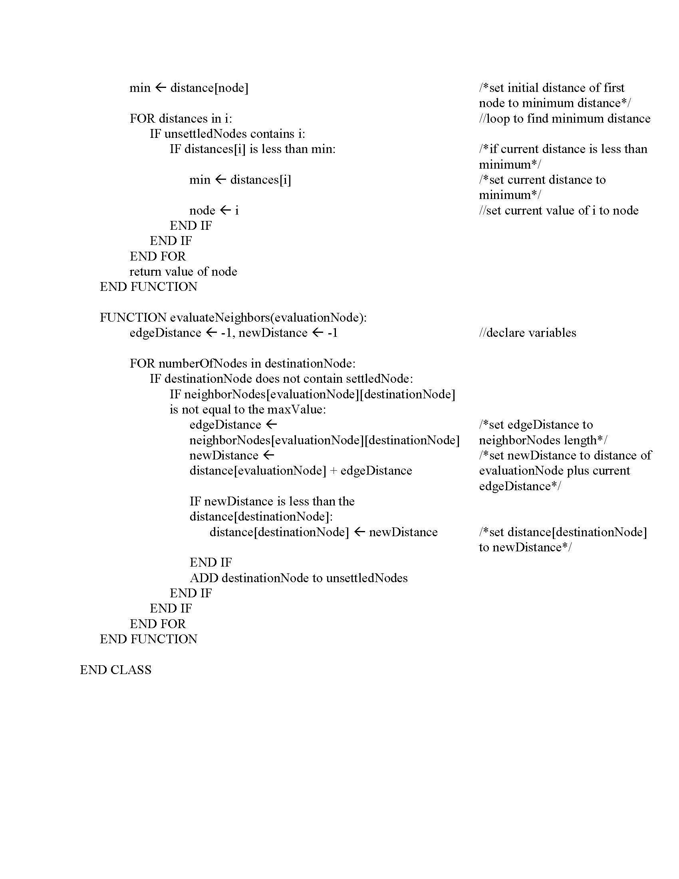
Software Requirements Specification Dijkstra Algorithm

Slide 22
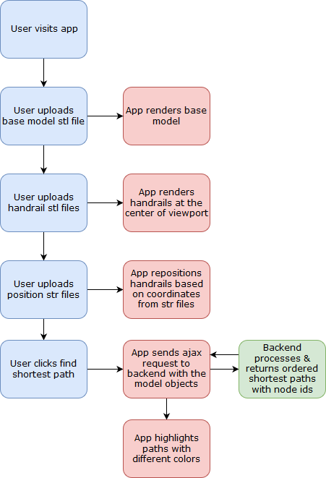
Software Requirements Specification User Interface Data Flow

Slide 23
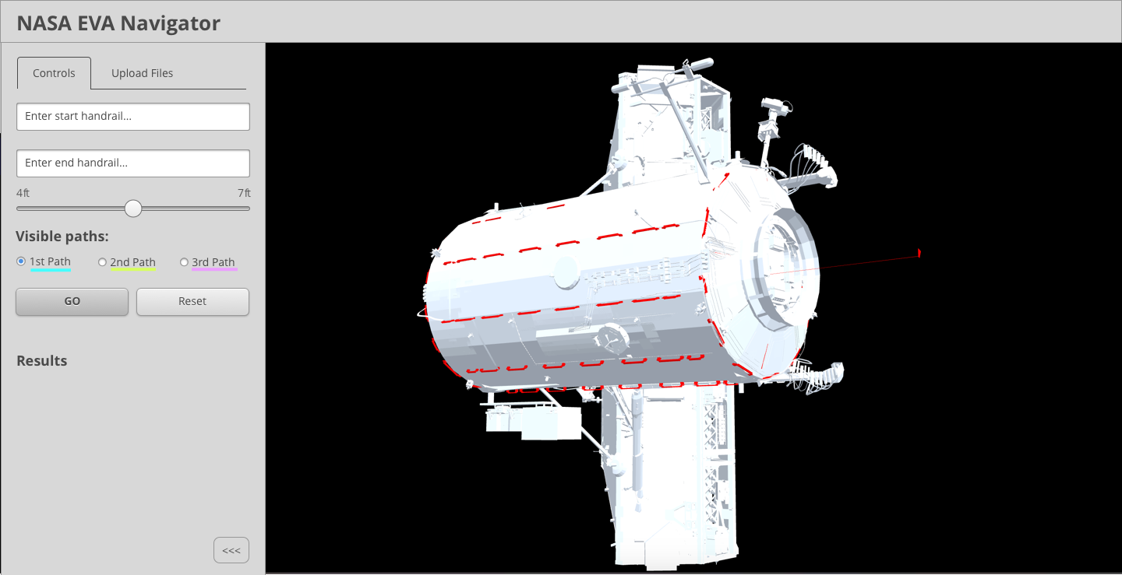
Software Requirements Specification Handrails in NASA Path Application Model
Highlighted in red.

Slide 24
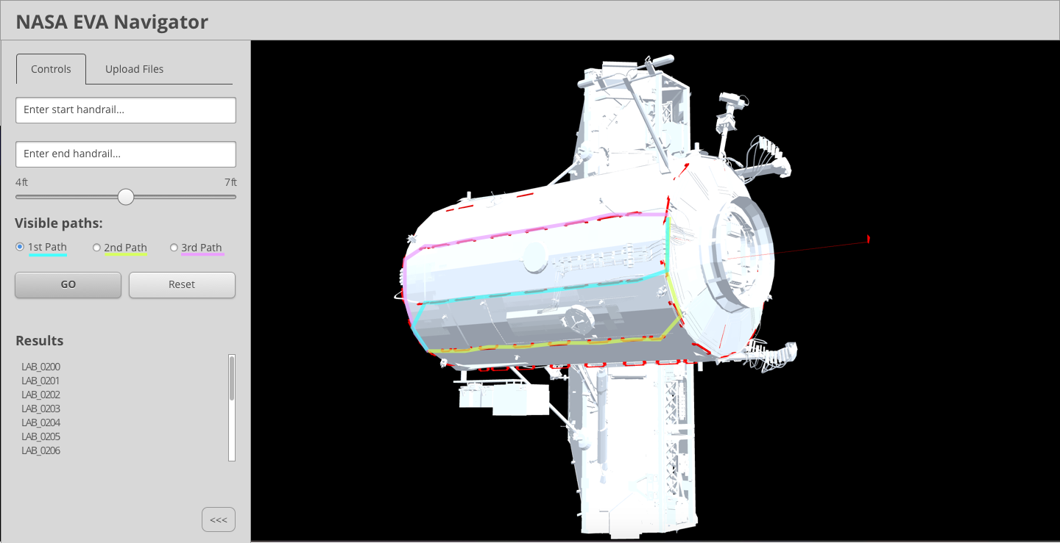
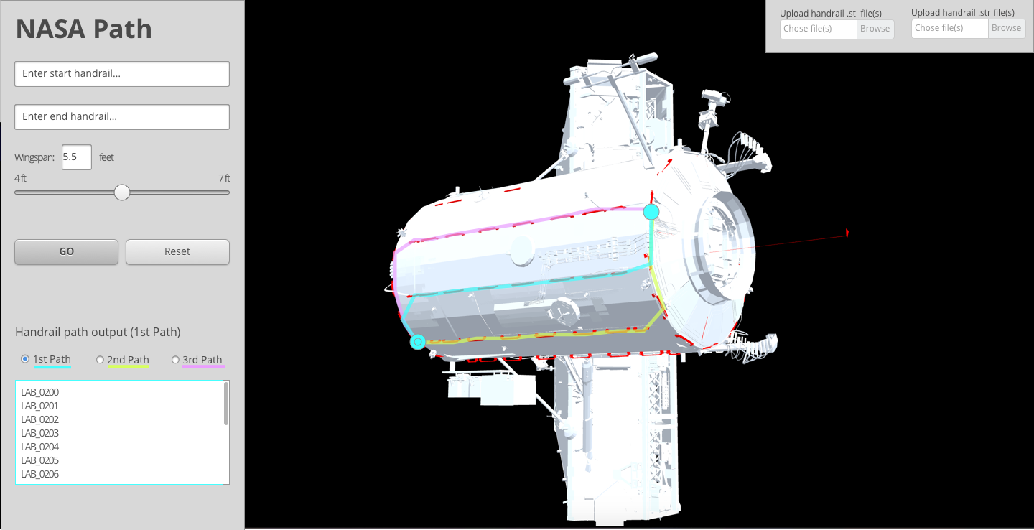
Software Requirements Specification Top Three Paths Calculated
Highlighted in 1. Cyan, 2. Magenta, and 3. Yellow.

Slide 25
Software Requirements Specification User Interface Mockup
Paths highlighted.

Slide 26
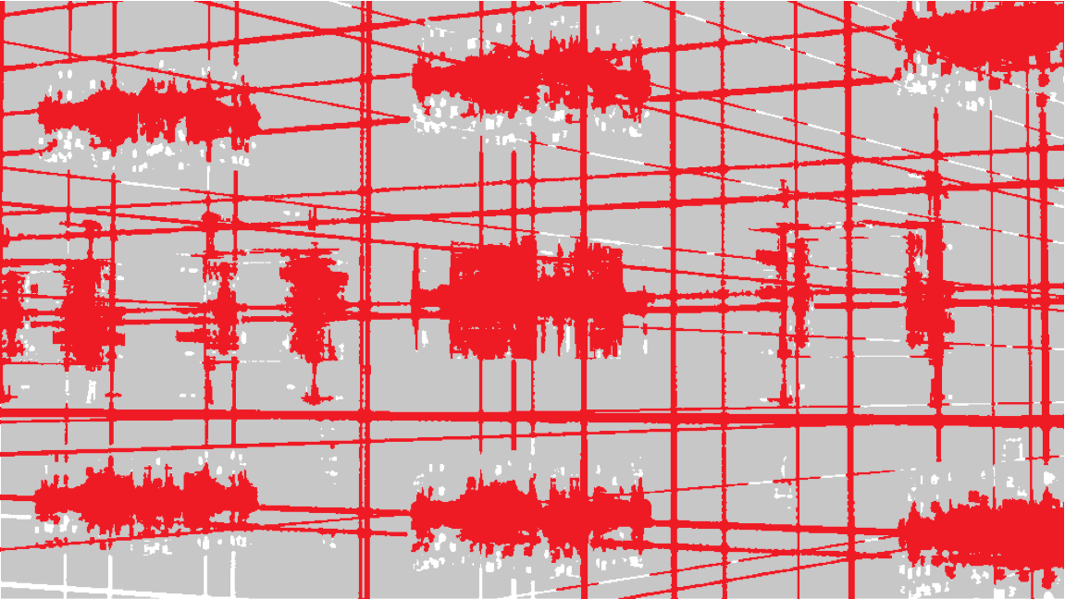
SOFTWARE DEVELOPMENT & IMPLEMENTATION NASA PATH
Notes:
Software development and implementation is the actual task of developing/programming the software; i.e., coding the software. Next, implementation begins with verification and validation, which is the process of checking that the software meets specifications and that it fulfills its intended purpose.

Slide 27
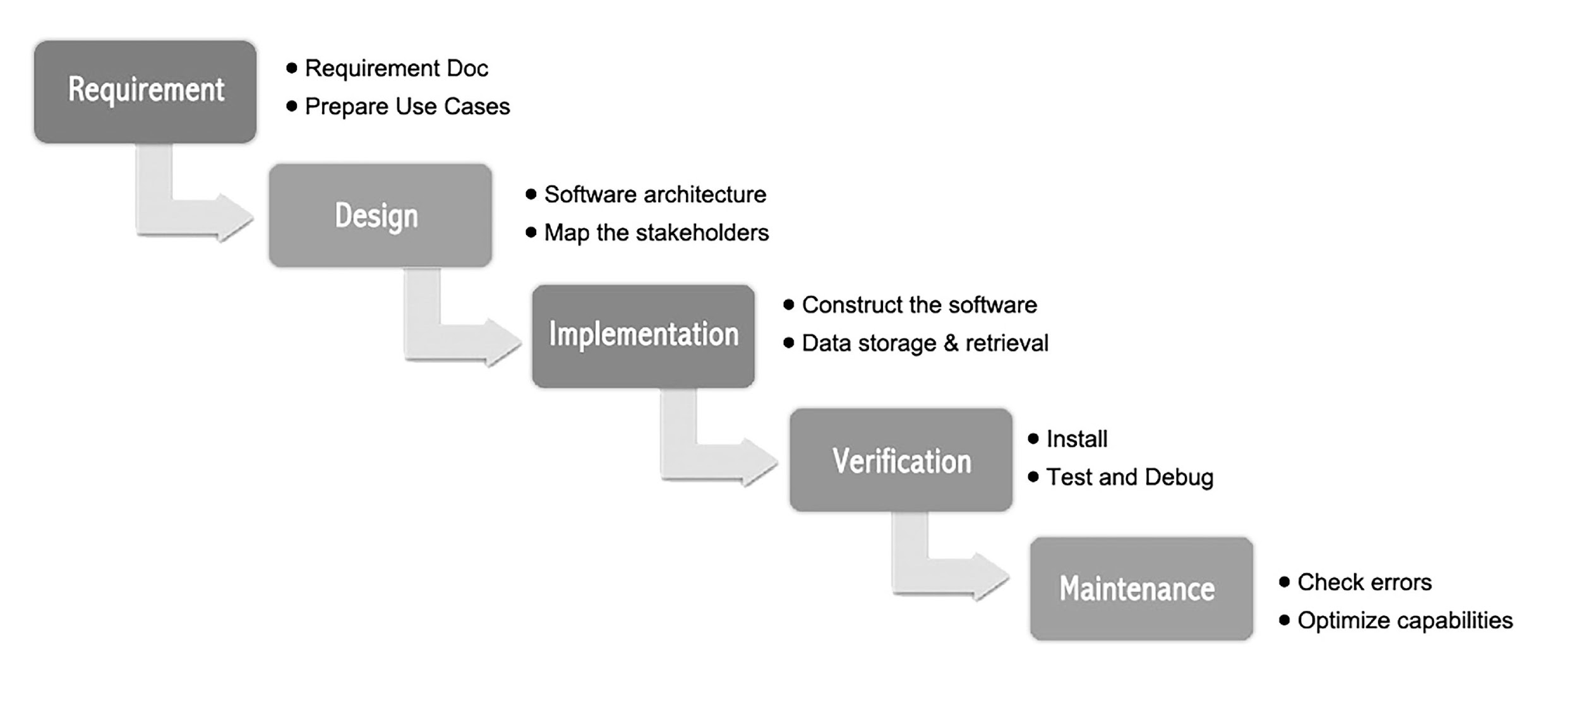
Software Development & Implementation Waterfall Methodology

Slide 28
Software Development & Implementation Waterfall Methodology: Phases
First Phase: Preliminary Analysis - conducting a preliminary analysis, proposing alternative solutions, describing benefits, and then submitting a preliminary plan with recommendations.
Second Phase: Requirements - defines the project objectives into well-defined functions and operation of the intended application, while analyzing end-user information needs.
Third Phase: Design - describes the desired features and operations in detail, which includes screen layouts, business rules, process diagrams, pseudocode and other documentation.
Fourth Phase: Implementation, Integration, Testing or Validation - implements the real code and brings all the phases together to form a special testing environment, which thereafter, checking for errors, bugs and interoperability commence.
Fifth Phase: Deployment or Installation - represents the final stage of the initial development, as the software is put into production and runs.
Sixth Phase: Maintenance - involves modifications, improvements, add-ons, and the movement to different processing platforms.

Slide 29
Software Development & Implementation Approaches
The software architecture is:
Web-based
Used over the Internet with a Web browser
The client side scripting/coding consists of:
JavaScript/Java, and
The Dijkstra Algorithm (modified for 3D)
The server side consists of:
Docker Development Environment, and
Git

Slide 30
Software Development & Implementation Programming Language
JavaScript/Java:
Implement Front-End and Back-End
Using API or services architecture to communicate between the two

Slide 31
Software Development & Implementation Development Environment
Docker Development Environment (DDE)
The DDE is a Docker container
The Docker repository and its Dockerfile created:
A Docker image
Executed a Docker container, and
Developed code in the container
Docker built, tested, and released new Docker versions using this container
For each software commit:
A new Docker container was built, and
Tests were executed
After successful tests, the new changes were deployed to the stable release

Slide 32
Software Development & Implementation Verification & Validation
A review with the client at each milestone ensured that the software was developed according to expectations.
A test plan for the project was submitted as part of Milestone 2.
Milestone 3 included a demonstration of the working software.
The client had access to the Github demonstration link to review and provide feedback throughout development.
Adjustments based on feedback were made accordingly before final delivery.
Provided they were received up to 2 weeks prior to Milestone 4, and
Provided they fit within the agreed upon scope of the project
Two weeks of testing by the development team was concluded prior to handoff to the client in Milestone 4
To ensure the software met the stated requirements before delivery

Slide 33
Software Development & Implementation Codebase Version Control
GitHub
Software housed on GitHub (Publicly)
Software released under free and open source license
Distributed Version Control System
Designed for small to large projects
Offers: Local branching, Staging areas, and Multiple workflows

Slide 34
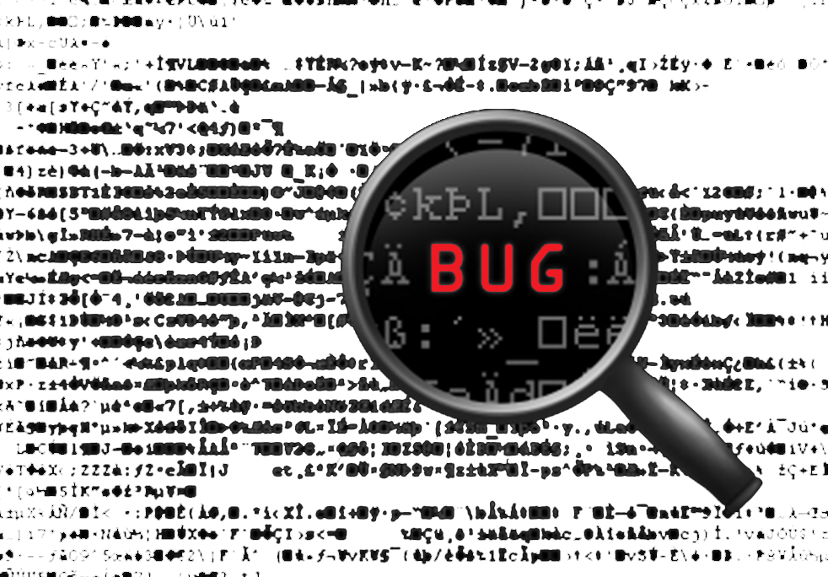
TEST PLAN & DEPLOYMENT NASA PATH
Notes:
Testing assesses the software for errors and bugs against the requirements. Testing includes functional testing such as unit testing, integration testing (if applicable), software testing, and acceptance testing, as well as non-functional testing. After testing, the software is delivered/deployed to the client.

Slide 35
Test Plan & Deployment Test Plan Purpose
Describe the testing
What to test?
Who will perform the testing?
Complete test plan and test cases
To test the functionality based on given software requirements specification
Functional and nonfunctional tests are used
To determine if the code execution meets the requirements

Slide 36
Test Plan & Deployment Test Plan Objectives
Tested that algorithm calculated valid path(s) around the exterior of the ISS using a 3D model, where primary tasks included:
Determining crewmember’s particular location with entered value
Navigating crewmembers to specified end point
Establishing path(s) shortest distance
Avoiding path(s) encounter with least hazards
Determining path(s) requirement within specified arm reach (wingspan)
Tested that 3D model represented the exterior of the ISS using handrails and structural beams, where represented objects included:
Available handrails
Lists of some objects protruding from structural surface
Tested the rendering of the shortest path(s) in the software for the user that accommodated a given wingspan (from input that ranged from 4ft. to 7ft.)

Slide 37
Test Plan & Deployment Test Plan Type and Methodology
Test Type:
Function Test - Tested the basic requirements necessary for designing and implementing the software
Verified and validated the software’s functionality based on the features required
Test Methodology:
Structure-Based (White-Box) – Is based on the internal structure rather than external function
Ensured that each statement in the code of the software was executed at least once
Tested code written to implement the software
Checked that the software did everything that its specification said it should do
Used to supplement functional methods, ensured that enough of the code was exercised during testing (checking statement and decision coverage for complete code coverage)

Slide 38
Test Plan & Deployment Test Plan Evaluation Methods
Data Collection Methods:
Quantitative – Collected performance data
Based on findings counted and measured against benchmarks established to determine success or failure
Each metric was based on data
Noted participants’:
comments as they were thinking out loud while they worked
responses to open-ended questions in an interview after they had completed scenarios
responses at the end of the testing session
Qualitative – Collected performance data
Based on measurements of users’ actions of success or failure at task completion

Slide 39
Test Plan & Deployment Test Plan Environment and Equipment
Facility equipment included:
Monitor
Keyboard
Mouse
Internet connection or data connection
Computers required:
Windows 7 or higher
Mac OS X or higher
Ubuntu 14 or higher
Testing environment required:
TCP/IP Network
Internet
Chrome, Firefox, and Internet Explorer (IE) Web browsers

Slide 40
Test Plan & Deployment Test Plan Participants
Primary testing was conducted by the UMUC NASA Path team
Additional testers can be recruited by the NASA client

Slide 41
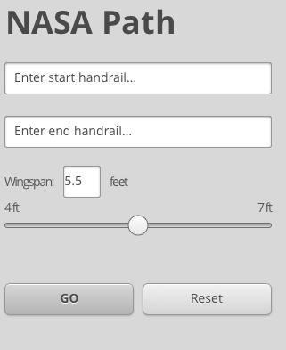
Test Plan & Deployment Design and Implementation Constraints
Start, end, and wingspan inputs.

Slide 42
Test Plan & Deployment Test Plan Deliverables
Reports were delivered following testing, which included:
Test Plan
Test Cases
Test Scripts
Defect/Enhancement Logs/Test Reports
Test Summary Reports
The method and type of delivery consisted of:
Electronic Document
Delivered: Milestone 4 – December 3, 2017

Slide 43
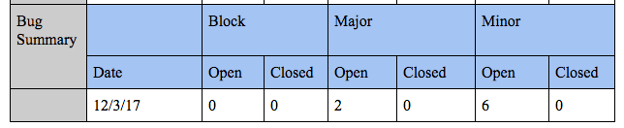
Test Plan & Deployment Test Results Summary
Testing was conducted the week of 11/26/17 before milestone 4 (12/3) in accordance with the NASA Path Test Plan. Testing was conducted with the following desktop browsers with the application run locally downloaded from https://lovetostrike.github.io/nasa-path-finder/demo.html
PC Chrome
PC Firefox
PC IE11
MAC Chrome
MAC Firefox
Testing was conducted from the perspective of each target user: User #1 is an Astronaut and considered a favored user; User #2 is an Astronaut Trainer; and User #3 is a Spacewalk Procedure Writer. The DOUG application was not covered in testing.

Slide 44
Test Plan & Deployment Test Results - Defects and Enhancements
The following defects and possible enhancements were documented from the test cases:
Major. The Wingspan/arm reach slider had no effect on the path calculation.
Major. It was not possible to select decimal Wingspan values.
Minor. Upload files prompt accepts drag/drop file uploads as well as click to upload. However adding an upload button or click to upload instruction may be clearer.
Minor. It was possible to select the same handrail as both the start and end.
Minor. As an enhancement, allow options for replacing handrails or updating them on upload in addition to adding them.
Minor. As an enhancement, update algorithm to automatically avoid “Keep Out Zone” around hazards without requiring manual inspection and alternate path selection.
Minor. IE11 performance on initial load lags well behind other browsers (16 seconds versus 2-3 seconds).
Minor. Since GitHub does not support running Java applications, the full backend application will only run on the local environment. On the GitHub link, the calculated path is loaded with sample data.

Slide 45
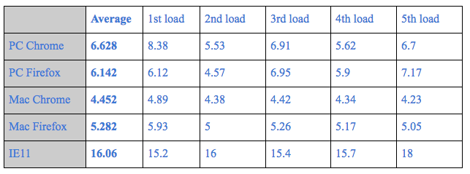
Test Plan & Deployment Test Results - Performance testing
In terms of overall performance the application takes the longest on initial load. This seems to be due to the large stl and str files being loaded into the DOM (over 42MB). Once the application was loaded and all stl, str files were cached, all additional interactions such as calculating paths were performed instantaneously. This issue should be lessened when running the application locally instead of on a remote server. The average initial load times for each browser (in seconds) on a high-speed fiber broadband connection (100 Mbps) is below:

Slide 46
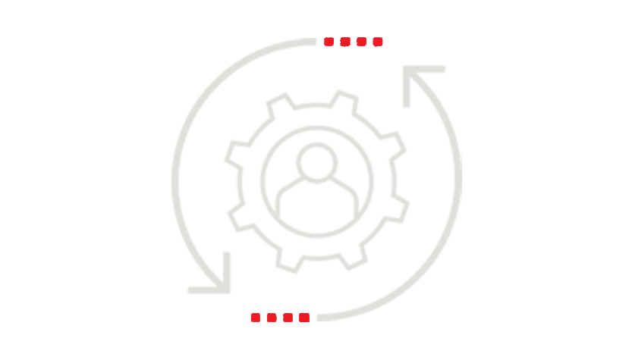
MAINTENANCE & DOCUMENTATION PLAN NASA PATH
Notes:
Maintenance is the process of maintaining the software and providing upgrades to adapt to changes. Documentation documents the internal design of software for the purpose of future maintenance and enhancement, this could also be used as a Readme file for training and support.

Slide 47
Maintenance & Documentation Plan Strategy
For continued development and maintenance
Software will be housed on GitHub Distributed Version Control System
Software will be Public
Software will be released under free and open source license
Documentation
README file

Slide 48

SUMMARY NASA PATH

Slide 49
Project Summary
Milestones
1: Delivered on October 1, 2017 – Project Plan & PowerPoint Presentation
2: Delivered on October 22, 2017 – Software Requirements Specification, Test Plan, & Pseudocode
3 : Delivered on November 12, 2017 – Prototype (Demo) & Testing
4: Delivered on December 3, 2017 – Regression, Quality Assurance, Signoff, PowerPoint Presentation, & Final Application Delivery
Project Methodology: Waterfall
Preliminary Analysis – Team submits a preliminary plan with recommendations
Requirements – Team defines the project objectives and analyzes end-user requirements
Design – Team describes the desired features and operations in detail
Implementation, Integration, Testing or Validation – Team implements the code
Deployment – Team puts software into production and executes the software
Maintenance – Team modifies, improves, and moves software to different processing platforms
Final software deliverables
GitHub Distributed Version Control System
Software should be Public
Software released under free and open source license

Slide 50
Project Summary Continued
Overall Architecture
Web-based Software – Used over the Internet (TCP/IP) with a web browser (Chrome, Firefox, IE)
Client Side Scripting/Coding – JavaScript/Java & Dijkstra Algorithm (Modified for 3D)
Server Side Scripting/Coding – Docker Development Environment & Git
Testing
Quality Assurance and Bug Testing, Multiple Browser Compatibility, Application Security, & Performance - Load and Stress Testing
Deployment
Usability Software housed publicly on GitHub
Maintenance & Documentation
Software will be housed on GitHub Distributed Version Control System
Software will be Public
Software will be released under free and open source license
README file

Slide 51
Research
Asahi Technologies (2016). Waterfall methodology [Image]. Retrieved from https://www.asahitechnologies.com/wp- content/uploads/2016/02/Waterfall.jpg
Docker, Inc. (2017). What is Docker? Retrieved from https://www.docker.com/what-docker
Duckett, J. (2014). JavaScript & Jquery: Interactive front-end web development. Indianapolis, IN: John Wiley & Sons, Inc.
Infoicon Technologies. (2016). Development process [Image]. Retrieved from http://www.infoicontechnologies.com/assets/images/mobile-app-new.jpg
Pelosi, M. (2016). Modern software methodologies for software engineering. Document posted in University of Maryland University College SWEN 603 9040 online classroom, archived at: http://campus.umuc.edu
Sedgewick, R., & Wayne, K. (2011). Algorithms (4th ed.). Upper Saddle River, NJ: Pearson Education, Inc.
Stallings, W., & Case, T. (2013). Business Data Communications: Infrastructure, Networking, and Security (7th ed.). Upper Saddle River, NJ: Pearson Education, Inc.
Vogel, L. (2009, 2016). Dijkstra’s shortest path algorithm in Java – Tutorial: Vogella GmbH version 1.2, 29.09.2016. Retrieved from http://www.vogella.com/tutorials/JavaAlgorithmsDijkstra/article.html
Welsh, D. (2017). Navigation for space walks. Retrieved from https://github.com/darenwelsh/EVANav
WisdmLabs. (2016). Design process [Image]. Retrieved from https://wisdmlabs.com/site/wp-content/uploads/2016/02/app- design-process.png

